Slide 1

Singly Linked List : Applications Circularly Linked List : Operations and Applications
Dr. J.Govindarajan
Asst. Prof. (Sr.Gr)
CSE Department

Slide 2
Contents
Singly Linked Lists (SLL) : Applications
Stack
Queue
Circularly Linked List (CLL)
Representation
Problems in using SLL traversal algorithm for CLL
CLL with head, with head & tail, with tail
Functions
Applications
Implementation of Queue using CLL
Practice problems

Slide 3
Singly Linked Lists : Applications

Slide 4
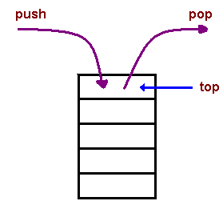
Stack using Singly Linked List
Stack Operation = > SLL Operation
Push(e) => addFirst(e)
Pop() => removeFirst()
top() => first()
size() => size()
O(1)
top
10
10
20
30
50
∅
20
30
top(head)
50

Slide 5
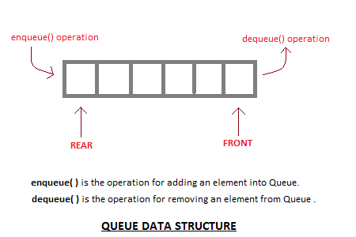
Queue using Singly Linked List
Queue Operation = > SLL Operation
enqueue(e)=> addLast(e)
dequeue() => removeFirst()
rear() => tail()
3
50
2
front (f)
rear (r)
15
20
40
15
1
50
∅
0
40
front(head)
rear(tail)
20

Slide 6
Singly Linked List (SLL) : Applications
Used to implement Separate Chaining of hash table
Web index which is array of keywords. For each keyword, a linked list of URLs which contain the keyword

Slide 7
Circularly Linked List

Slide 8
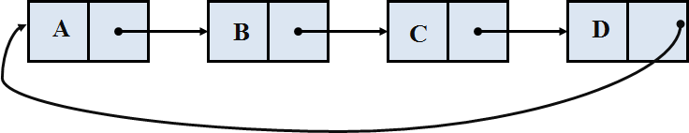
Circularly Linked List
Singly Linked Lists
Circularly Linked Lists
A
B
C
D
∅

Slide 9
SLL: Traverse and Print
temp = head
while (temp is not NULL) do
print temp.element
temp = temp.next
temp
A
B
C
D
∅
Output:
A B C D
head

Slide 10
Traverse and Print of SLL for CLL
temp = head
while (temp is not NULL) do
print temp.element
temp = temp.next
Infinite Loop
temp
head
Output:
A B C D A B C D A B C D ….

Slide 11
Traverse and Print : Circularly Linked List with head
temp = head
if (temp == NULL) then
return # List is empty
do
print temp.element
temp = temp.next
while (temp != head)
temp
head
Output:
A B C D

Slide 12
Traverse and Print : Circularly Linked List with both head and tail
temp = head
if (temp == NULL) then
return # List is empty
do
print temp.element
if (temp == tail) then
return # reached end of list
temp = temp.next
while (true)
Output:
A B C D
temp
head
tail

Slide 13
Traverse and Print : Circularly Linked List with tail
if (tail == NULL) then
return # List is empty
temp = tail.next
do
print temp.element
if (temp == tail) then
return # reached end of list
temp = temp.next
while (true)
Output:
A B C D
temp
tail

Slide 14
Traverse and Print : Circularly Linked List with tail
if (tail == NULL) then
return # List is empty
temp = tail.next
do
print temp.element
if (temp == tail) then
return # reached end of list
temp = temp.next
while (true)
A
Output:
A
tail

Slide 15
Update: Circularly Linked List with tail
if (tail == NULL) then
return # List is empty
temp = tail.next
do
if (temp.element==‘C’) then
temp.element=‘E’
return #update is completed
if (temp == tail) then
return # reached end of list
temp = temp.next
while (true)
temp
tail

Slide 16
Insert First: Circularly Linked List with tail
newnode = Node(e)
if (tail == NULL) then
tail = newnode
tail.next = tail
else
newnode.next = tail.next
tail.next = newnode
newnode
A
B
C
D
E
tail

Slide 17
Insert Last: Circularly Linked List with tail
newnode = Node(e)
if (tail == NULL) then
tail = newnode
tail.next = tail
else
newnode.next = tail.next
tail.next = newnode
tail = newnode
tail
tail
newnode
temp
A
B
C
D
E

Slide 18
Circularly Linked List
A circularly linked list provides a more general model than a standard linked list for data sets that are cyclic, that is, which do not have any particular notion of a beginning and end.

Slide 19
Circularly Linked List : Applications
Process Scheduler (Round Robin Scheduling)
Multi-Player Game with Round-robin
Load balancing with round-robin

Slide 20
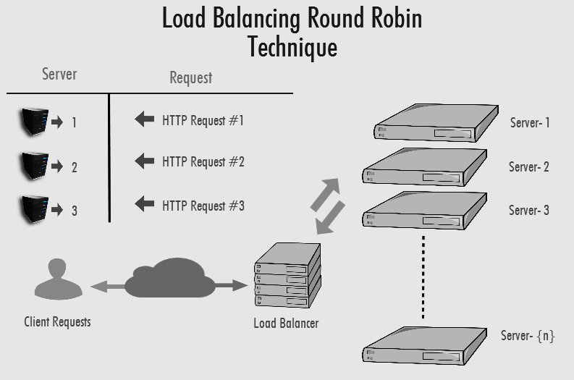
Load balancing with round-robin
Source: https://www.bodhost.com/kb/round-robin-dns/

Slide 21
Load balancing with round-robin
Request 1 => served by Server 4
S1
S2
S3
S4
Current = Current.next
Current

Slide 22
Load balancing with round-robin
Request 2 => served by Server 1
S1
S2
S3
Current
S4
Current = Current.next

Slide 23
Load balancing with round-robin
Request 3 => served by Server 2
S1
S2
S3
Current
S4
Current = Current.next

Slide 24
Load balancing with round-robin
Request 4 => served by Server 3
S1
S2
S3
Current
S4
Current = Current.next

Slide 25
Load balancing with round-robin
Request 5 => served by Server 4
S1
S2
S3
S4
Current = Current.next
Current

Slide 26
Load balancing with round-robin
Algorithm LoadBalancing(request)
//Server which is pointing by the Current variable
//process the request and give response to the client
response = Current.element.ProcessRequest(request)
//Update the Current Variable
Current = Current.next
//Return the response
return response
Current
S1
S2
S3
S4

Slide 27
FIFO (First In First Out) Process Scheduling using Queue implemented by SLL
Algorithm FIFOScheduling(Queue Q)
# Normal QUEUE behaviour
While (Q.Size() > 0 ) do
Current = Q.Dequeue()
//Process which is pointing by the Current
//allocated to CPU
AllocateCPUtoProcess(Current)
P1
P2
P3
CPU
Front
P4
NULL
Rear

Slide 28
Round-robin Process Scheduling using Queue implemented by SLL
Algorithm RoundRobinScheduling_SLL(Queue Q)
While (Q.Size()>0) do
Current = Q.Dequeue()
//Process which is pointing by the Current variable
//allocated to CPU
AllocateCPUtoProcess(Current)
Q.Enqueue(Current)
Overhead
Enqueue =>
create a node
insert the node
Dequeue=>
remove First
P1
P2
P3
CPU
P4
NULL
head
tail

Slide 29
Round-robin Process Scheduling using using Circularly LL
Algorithm RoundRobinScheduling_CLL()
While (Current is Not Null) do
//Process which is pointing by the Current variable
//allocated to CPU
AllocateCPUtoProcess(Current.element)
//Update the Current Variable
Current = Current.next
Current
P1
P2
P3
CPU
P4

Slide 30
Round-robin Process Scheduling
Using Queue implemented by SLL
P1
P2
P3
CPU
Using Queue implemented by SLL | Using CLL
Two references (head and tail) | one reference (Current)
Every time Removal and add | No removal
P4
NULL
head
tail
Using Circularly LL
Current
P1
P2
P3
CPU
P4

Slide 31
Round Robin Scheduling
Process | Total CPU Time
P1 | 10 Seconds
P2 | 20 Seconds
P3 | 30 Seconds
P4 | 20 Seconds
CPU
Service Time for one process in one round is 10 Seconds

Slide 32
Round Robin Scheduling
Remaining Time - Remaining Time Required to complete the task
Element <ProcessName,Remaining Time>
<P1,10>
<P2,20>
<P3,30>
<P4,20>
CPU
CPU serves a process for 10 Seconds in one turn

Slide 33
Round Robin Scheduling
Remaining Time - Remaining Time Required to complete the task
Element <ProcessName,Remaining Time>
Round1
<P1,10>
<P2,20>
<P3,30>
<P4,20>
Current
CPU Serves Process 1 for 10 Seconds
CPU
At the end of 10 Seconds
RemainingTime(P1) = RemainingTime(P1) – 10
= 10 – 10 = 0

Slide 34
Round Robin Scheduling
Remaining Time - Remaining Time Required to complete the task
Element <ProcessName,Remaining Time>
Round1
<P1,0>
<P2,20>
<P3,30>
<P4,20>
Current
Since Remaing Time required is Zero, P1 is removed from the list
Update the Current
CPU

Slide 35
Round Robin Scheduling
Remaining Time - Remaining Time Required to complete the task
Element <ProcessName,Remaining Time>
Round1
<P2,20>
<P3,30>
<P4,20>
Current
CPU serves P2 for 10 Seconds
CPU
At the end of 10 Seconds
RemainingTime(P2) = RemainingTime(P2) – 10
= 20 – 10 = 10

Slide 36
Round Robin Scheduling
Remaining Time - Remaining Time Required to complete the task
Element <ProcessName,Remaining Time>
Round1
<P2,10>
<P3,30>
<P4,20>
Current
Since RemainingTime(P2) > 0 after update, do not remove
CPU
Update Current

Slide 37
Round Robin Scheduling
Remaining Time - Remaining Time Required to complete the task
Element <ProcessName,Remaining Time>
Round1
<P2,10>
<P3,30>
<P4,20>
Current
CPU serves P3 for 10 Seconds
CPU
At the end of 10 Seconds
RemainingTime(P3) = RemainingTime(P3) – 10
= 30 – 10 = 20

Slide 38
Round Robin Scheduling
Remaining Time - Remaining Time Required to complete the task
Element <ProcessName,Remaining Time>
Round1
<P2,10>
<P3,20>
<P4,20>
Current
Since RemainingTime(P3) > 0 after update, do not remove
CPU
Update Current

Slide 39
Round Robin Scheduling
Remaining Time - Remaining Time Required to complete the task
Element <ProcessName,Remaining Time>
Round1
<P2,10>
<P3,20>
<P4,20>
Current
CPU serves P4 for 10 Seconds
CPU
At the end of 10 Seconds
RemainingTime(P4) = RemainingTime(P4) – 10
= 20 – 10 = 10

Slide 40
Round Robin Scheduling
Remaining Time - Remaining Time Required to complete the task
Element <ProcessName,Remaining Time>
Round1
<P2,10>
<P3,20>
<P4,10>
Current
Since RemainingTime(P4) > 0 after update, do not remove
CPU
Update Current

Slide 41
Round Robin Scheduling
Remaining Time - Remaining Time Required to complete the task
Element <ProcessName,Remaining Time>
Round2
<P2,10>
<P3,20>
<P4,10>
Current
CPU serves P2 for 10 Seconds
CPU
At the end of 10 Seconds
RemainingTime(P2) = RemainingTime(P2) – 10
= 10 – 10 = 0

Slide 42
Round Robin Scheduling
Remaining Time - Remaining Time Required to complete the task
Element <ProcessName,Remaining Time>
Round2
<P2,0>
<P3,20>
<P4,10>
Current
Since Reaming Time required is Zero, P2 is removed from the list
Update the Current
CPU

Slide 43
Round Robin Scheduling
Remaining Time - Remaining Time Required to complete the task
Element <ProcessName,Remaining Time>
Current
<P3,20>
<P4,10>
Round2
CPU serves P3 for 10 Seconds
CPU
At the end of 10 Seconds
RemainingTime(P3) = RemainingTime(P3) – 10
= 20 – 10 = 10

Slide 44
Round Robin Scheduling
Remaining Time - Remaining Time Required to complete the task
Element <ProcessName,Remaining Time>
Current
<P3,10>
<P4,10>
Round2
Since RemainingTime(P4) > 0 after update, do not remove
CPU
Update Current

Slide 45
Round Robin Scheduling
Remaining Time - Remaining Time Required to complete the task
Element <ProcessName,Remaining Time>
Current
<P3,10>
<P4,10>
Round2
CPU serves P4 for 10 Seconds
CPU
At the end of 10 Seconds
RemainingTime(P4) = RemainingTime(P4) – 10
= 10 – 10 = 0

Slide 46
Round Robin Scheduling
Remaining Time - Remaining Time Required to complete the task
Element <ProcessName,Remaining Time>
Current
<P3,10>
<P4,0>
Round2
Since Reaming Time required is Zero, P4 is removed from the list
Update the Current
CPU

Slide 47
Round Robin Scheduling
Remaining Time - Remaining Time Required to complete the task
Element <ProcessName,Remaining Time>
Current
<P3,10>
Round3
CPU serves P3 for 10 Seconds
CPU
At the end of 10 Seconds
RemainingTime(P3) = RemainingTime(P3) – 10
= 10 – 10 = 0

Slide 48
Round Robin Scheduling
Remaining Time - Remaining Time Required to complete the task
Element <ProcessName,Remaining Time>
Current
<P3,0>
Round3
Since Reaming Time required is Zero, P3 is removed from the list
Update the Current
CPU

Slide 49
Round Robin Scheduling
Remaining Time - Remaining Time Required to complete the task
Element <ProcessName,Remaining Time>
Current = Null
CPU
Current is NULL after update. That means no more process to serve; hence scheduler stops

Slide 50
Round-robin Process Scheduling
Algorithm RoundRobinScheduling()
While (Current is Not Null) do
//Process which is pointing by the Current variable
//allocated to CPU
p = Current.element
AllocateCPUtoProcess(p)
p.remainingtime = p.remainingtime – 10
if (p.remainingtime <= 0) then
remove p
//Update the Current Variable
Current = Current.next
CPU
<P1,10>
<P2,20>
<P3,30>
<P4,20>
Current

Slide 51
Queue using Circularly Linked List
IsEmpty()
if (Size() > 0) then
return False
else
return True
Size()
return Size
3
front( )
If (IsEmpty()== True) then
return Queue is Empty
else
head = tail.next
return head.element
50
2
front (f)
rear (r)
15
1
20
40
15
50
0
40
20
rear(tail)

Slide 52
Queue using Circularly Linked List
enqueue_CLL(e)
newnode = Node(e)
if (IsEmpty()) then
tail = newnode
tail.next = tail
else
newnode.next = tail.next
tail.next = newnode
tail = newnode
Size = Size + 1
3
50
2
front (f)
rear (r)
15
1
20
40
15
50
0
40
20
rear(tail)

Slide 53
Queue using Circularly Linked List
dequeue_CLL()
if (isEmpty()==True) then
return Queue is empty
else
head = tail.next
tail.next=head.next
head.next = NULL
Size = Size - 1
return head.element
3
50
2
front (f)
rear (r)
15
1
10
20
30
50
0
40
20
rear(tail)

Slide 54
Problems
Write an algorithm to remove the last node from the circularly linked list with only head pointer. Also specify the time complexity.
Write an algorithm to remove the last node from the circularly linked list with tail pointer. Also specify the time complexity.

Slide 55
Problems
Consider link list ‘L’ with head pointer. Write an algorithm to check whether given linked list is singly linked or circularly linked list.
Suppose the reference two nodes namely X and Y are given. Write an algorithm to check whether X and Y are belongs to same circularly linked list or belongs to different two different Circularly linked list.

Slide 56
Text Book Reference
Refer Goodrich MT, Tamassia R, Goldwasser MH. Data structures and algorithms in Python. John Wiley & Sons Ltd; 2013”

Slide 57
Other References
Goodrich MT, Tamassia R, Data structures and algorithms in Java. Fifth edition, John Wiley & Sons; 2010.
Tremblay JP, Sorenson PG. An introduction to data structures with applications. Second Edition, McGraw-Hill; 2002.
Shaffer CA. Data Structures and Algorithm Analysis. Third Edition, Dover Publications; 2012.

Slide 58
Online Meet
Online meet is on scheduled on 18th April 2020 from 6 to 7 PM to discuss and clarify the doubts.
The room id and password for online meet using yoteachapp.com will be shared.
Quiz and Assignment
Online Quiz is on scheduled on 19th April 2020 from 6 to 6.30 PM.
In addition Assignment will be opened on 19th April 2020.

